Slide 1


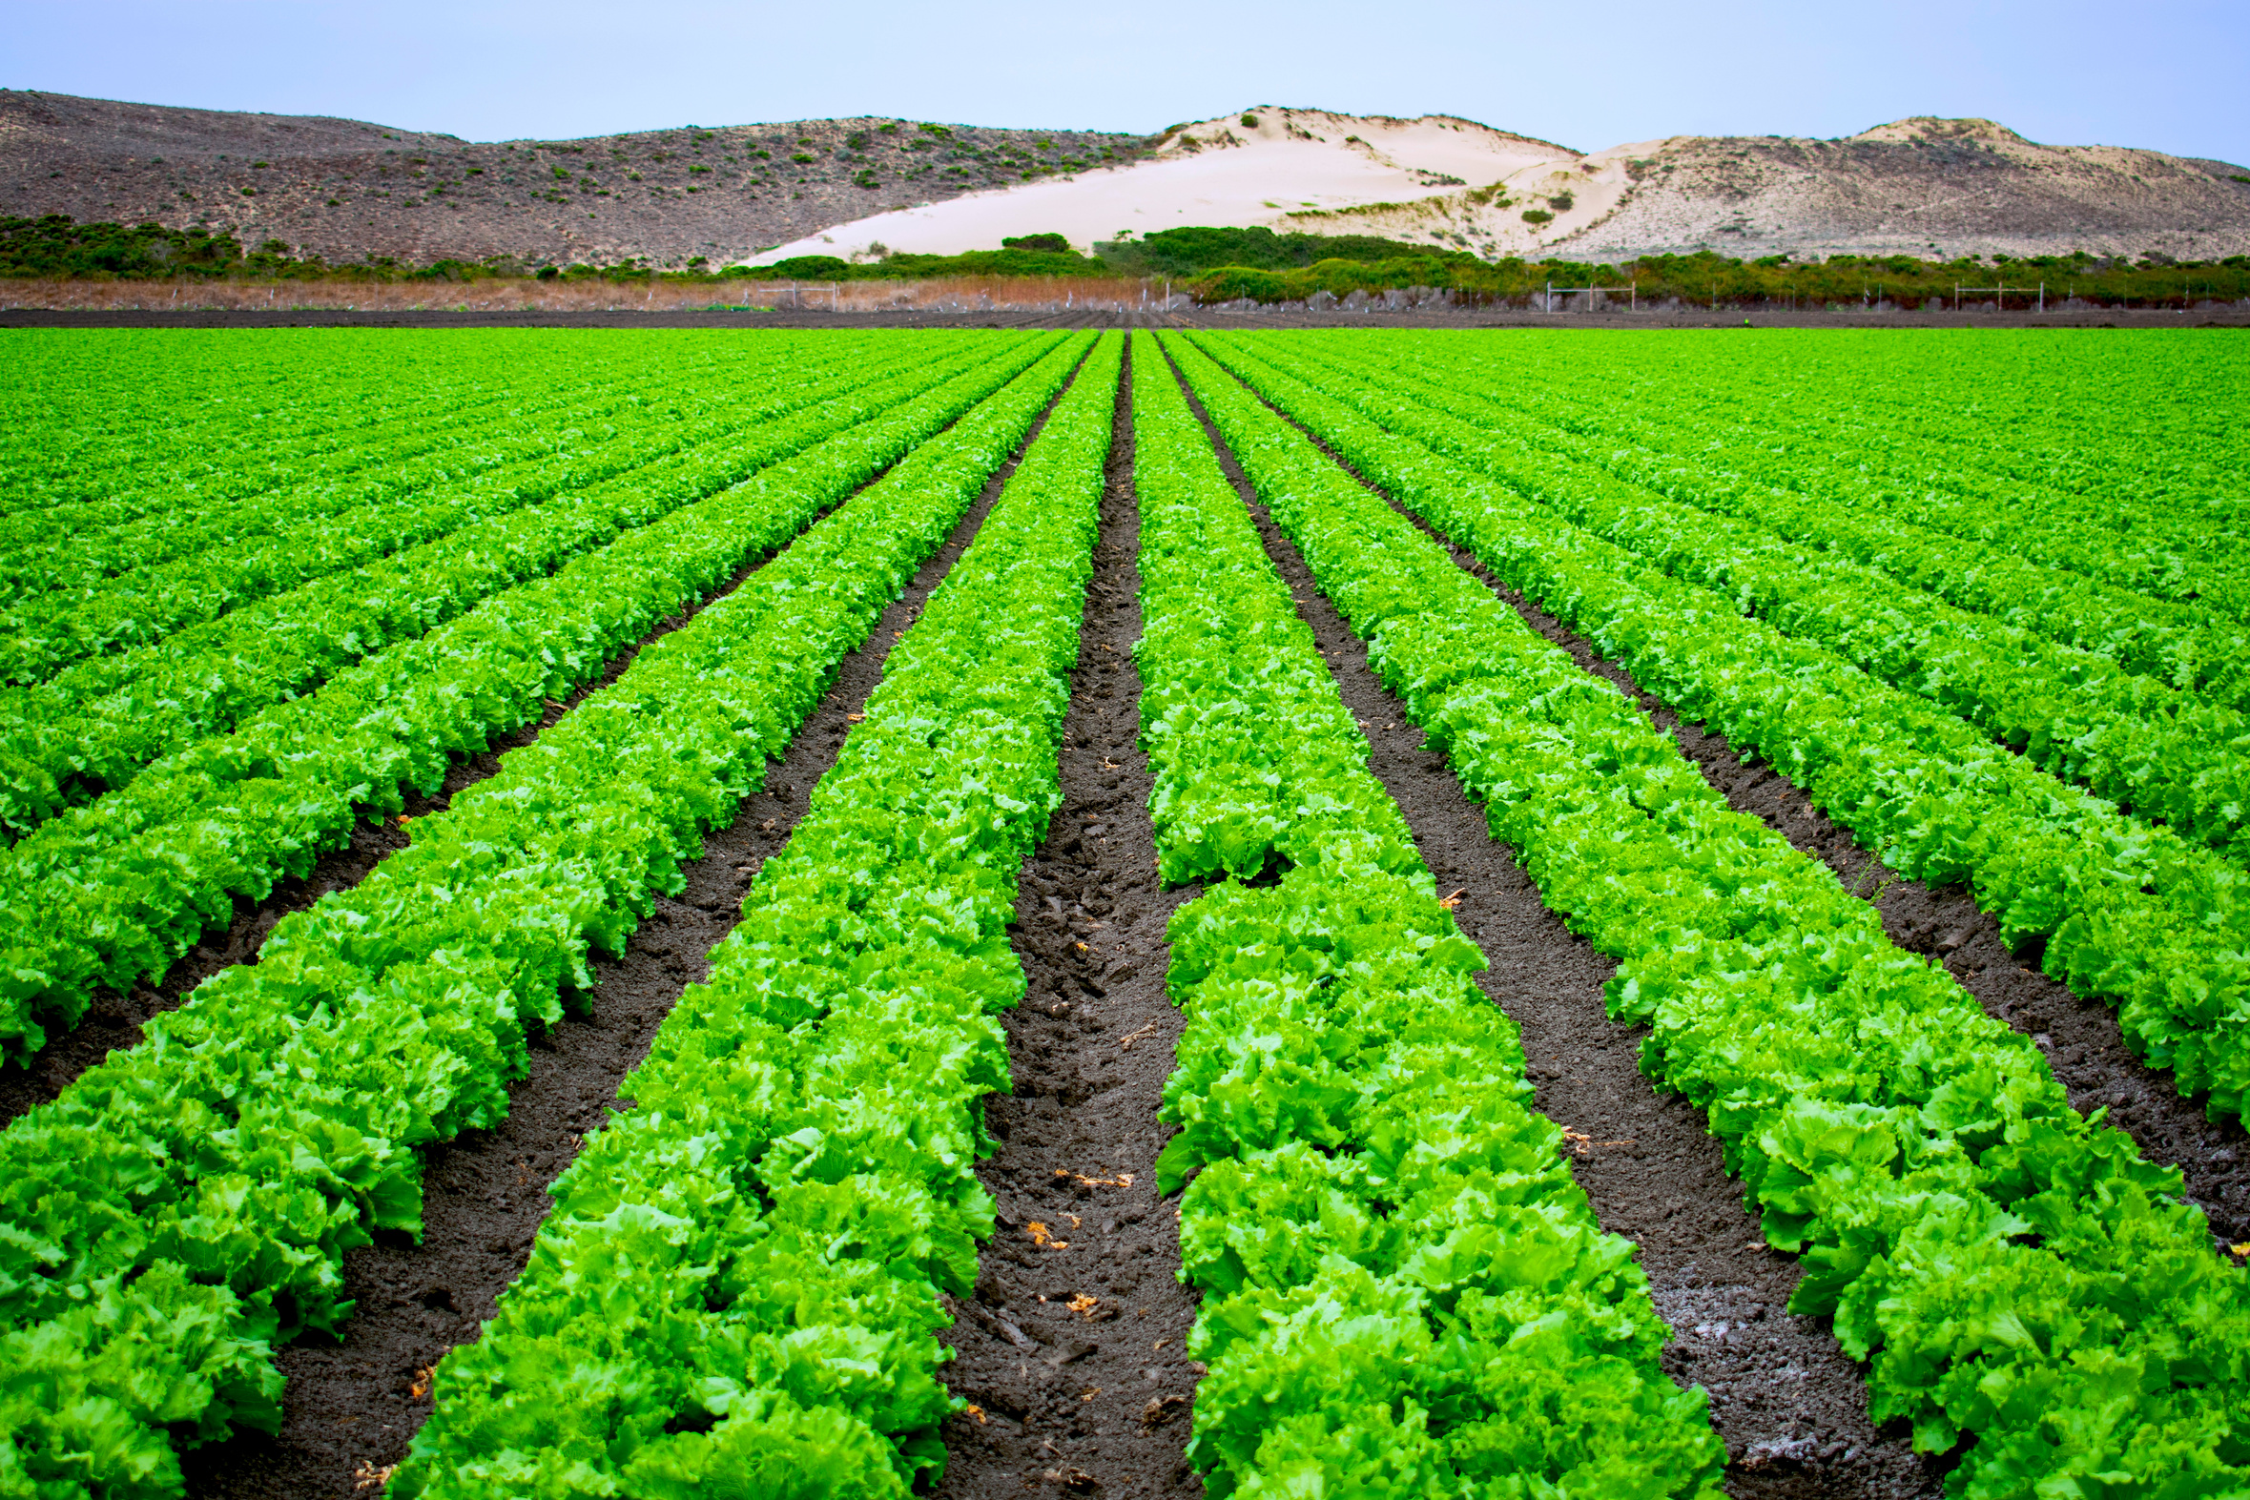

AI IRRIGATION
SQUAD
Presentation 2024
INTELLIGENT VALVE CONTROL MECHANISM FOR IRRIGATION IN PRECISION AGRICULTURE
JSPM NARHE TECHNICAL CAMPUS

Slide 2

Content
01
Introduction
02
Objective
03
Hardware and Software
04
Data Visualisation
05
Machine Learning Model
06
App Development
07
Team Details

Slide 3

Introduction
Traditional irrigation methods fall short in precision and sustainability, leading to water wastage and suboptimal crop growth. To address this, we present an innovative solution: an AI-powered intelligent irrigation system.
This system utilizes advanced sensors and AI algorithms to regulate water release based on real-time soil moisture data, optimizing water usage and crop yield.

Slide 4





Objectives
Objective 01
·Accurately predict crop water requirements.
Objective 02
·Make decisions about water release timing and quantities to use water efficiently.
Objective 03
AI Irrigation Squad
·Be integrated with existing piped and micro irrigation networks.
Objective 04
·Be user-friendly and accessible to farmers.

Slide 5


Hardware and Software
Raspberry Pi 4b
Moisture sensor , Temperature sensor , Rain sensor
Automated valve mechanism (Solenoid Valve)
ML Model
Operating System
User Interface(App)

Slide 6

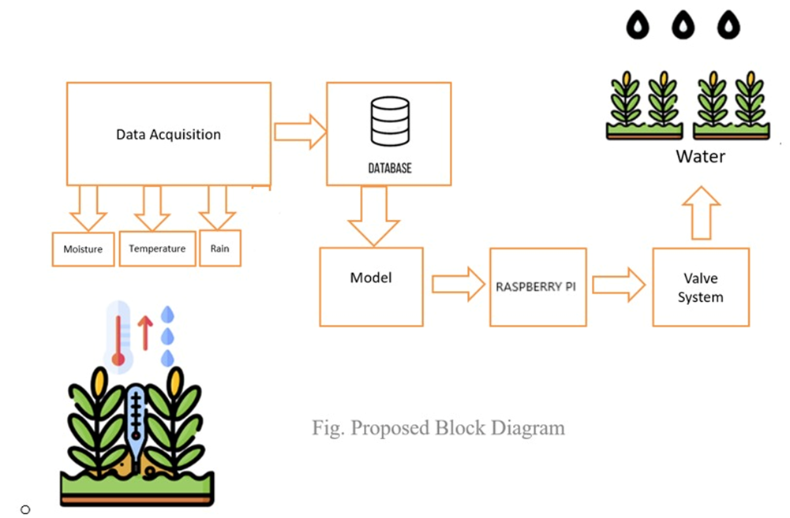
PROPOSED SYSTEM

Slide 7

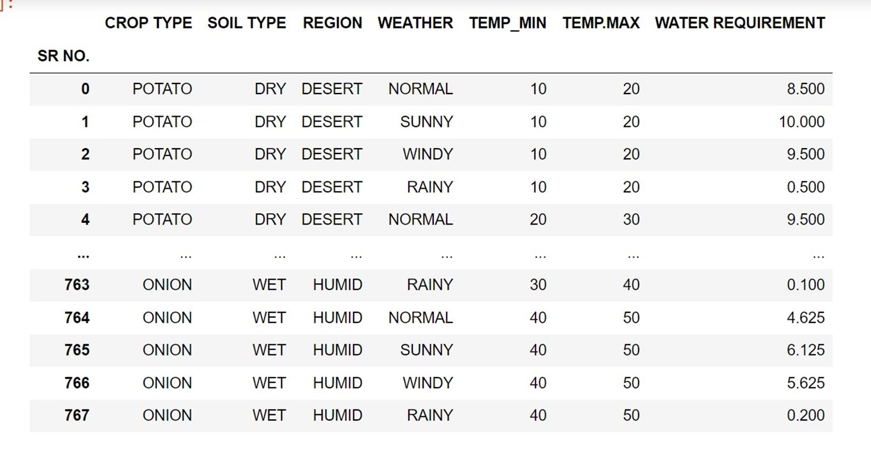

Dataset

Slide 8
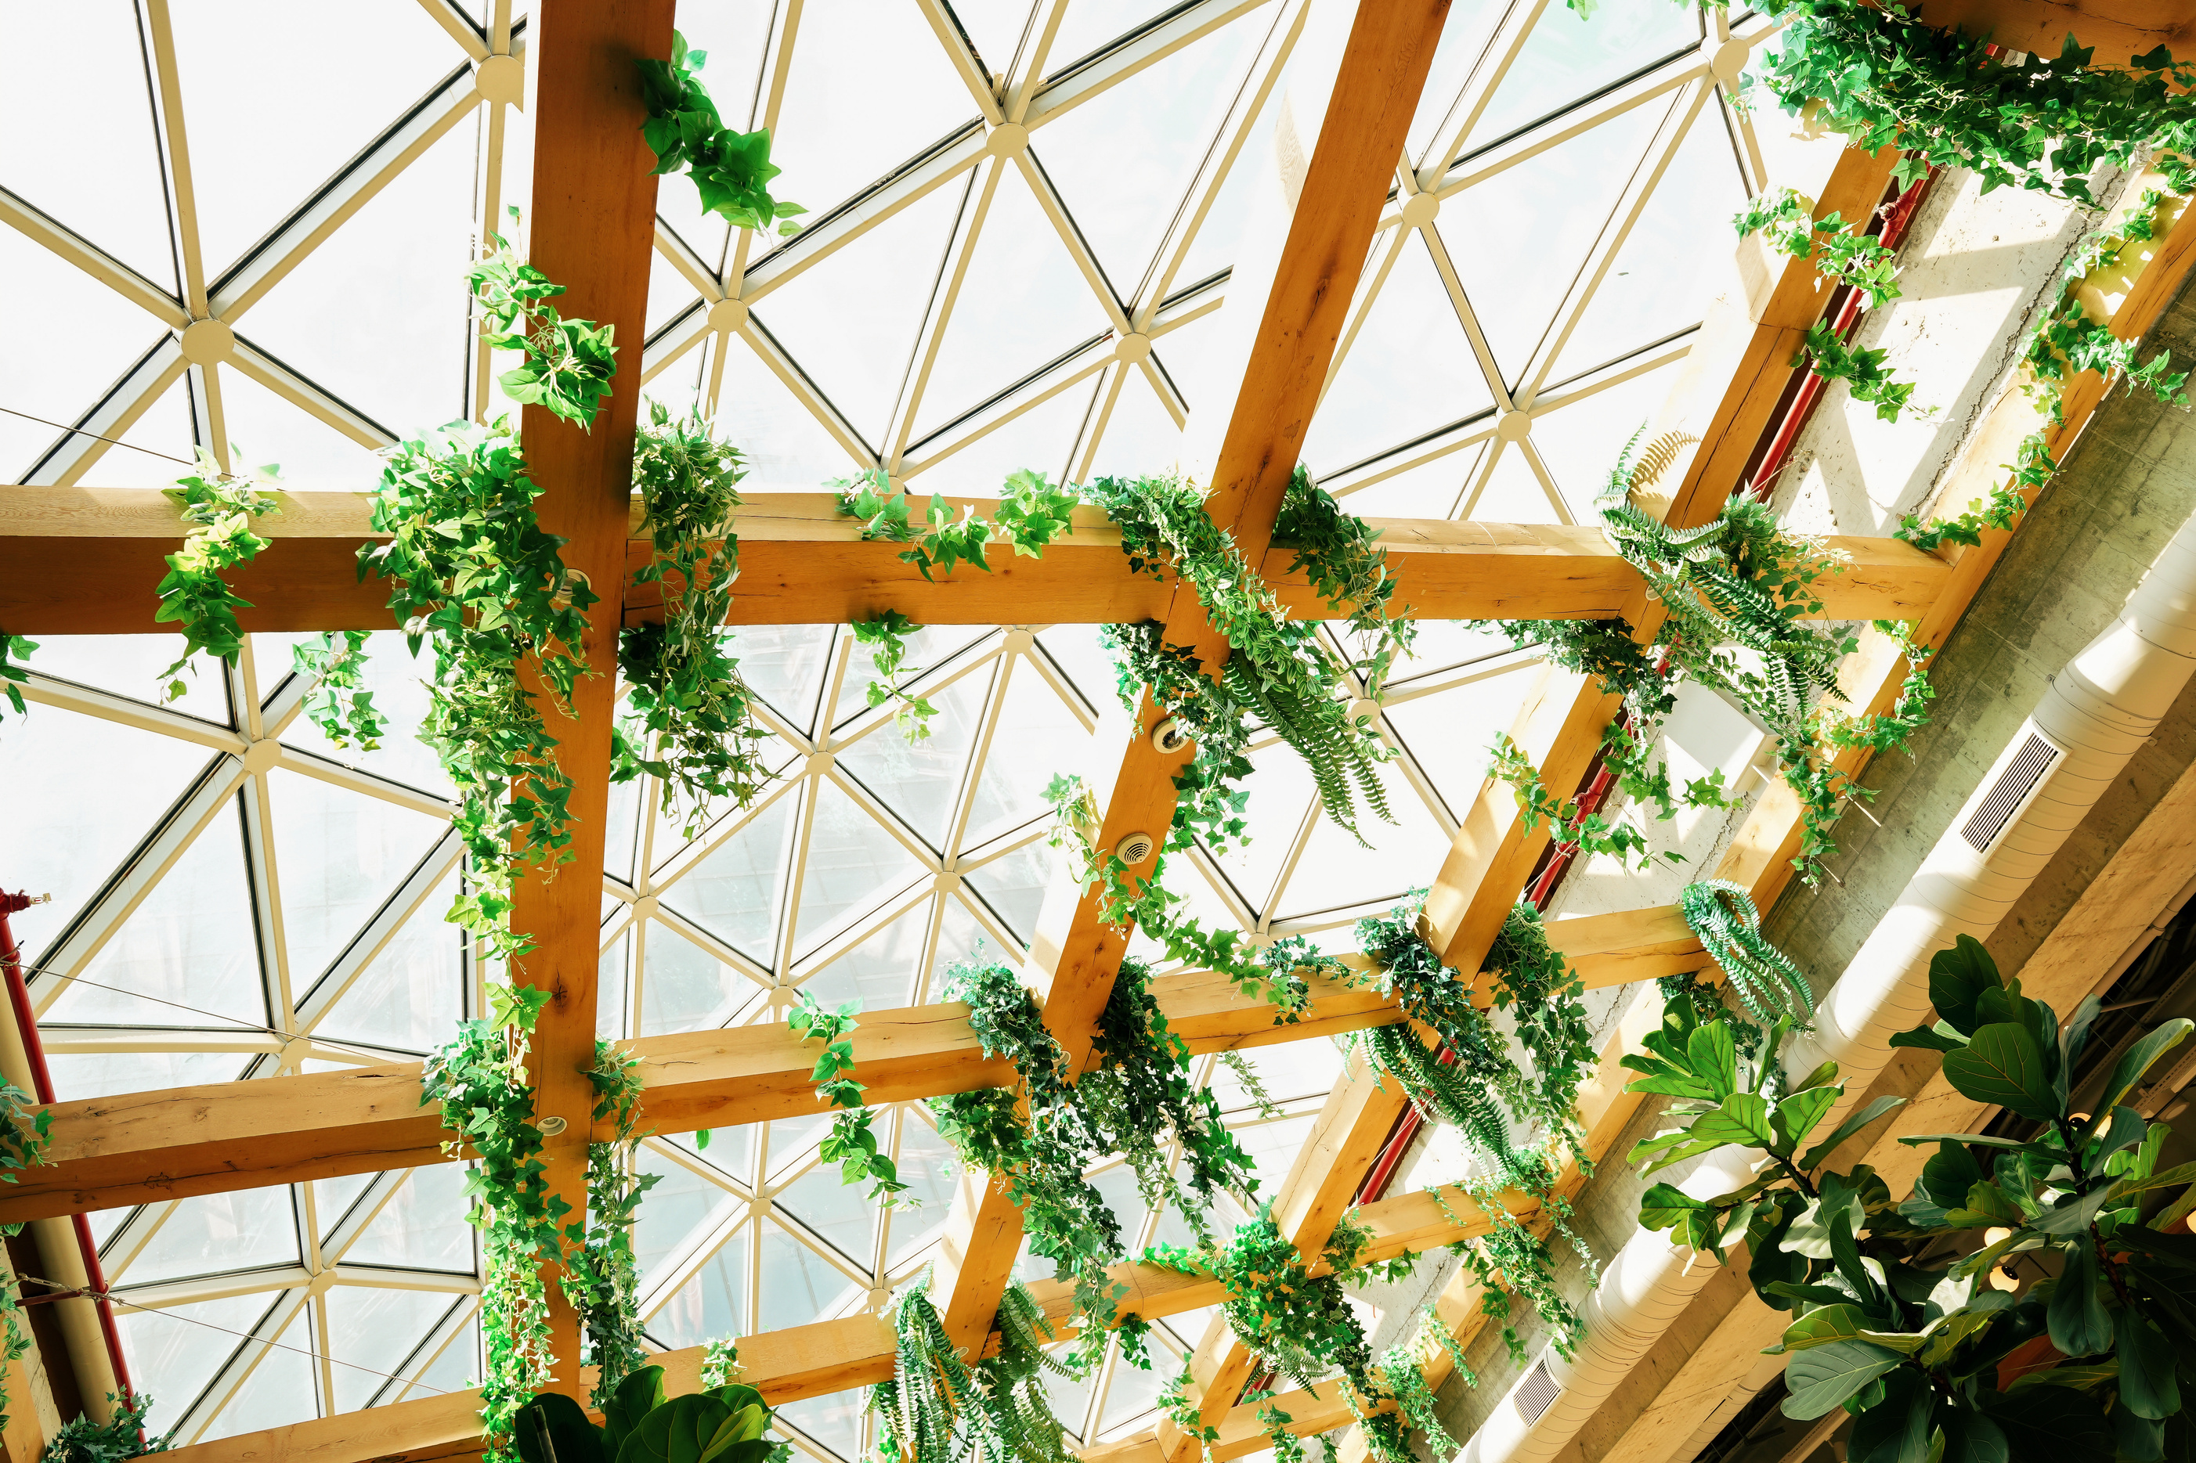
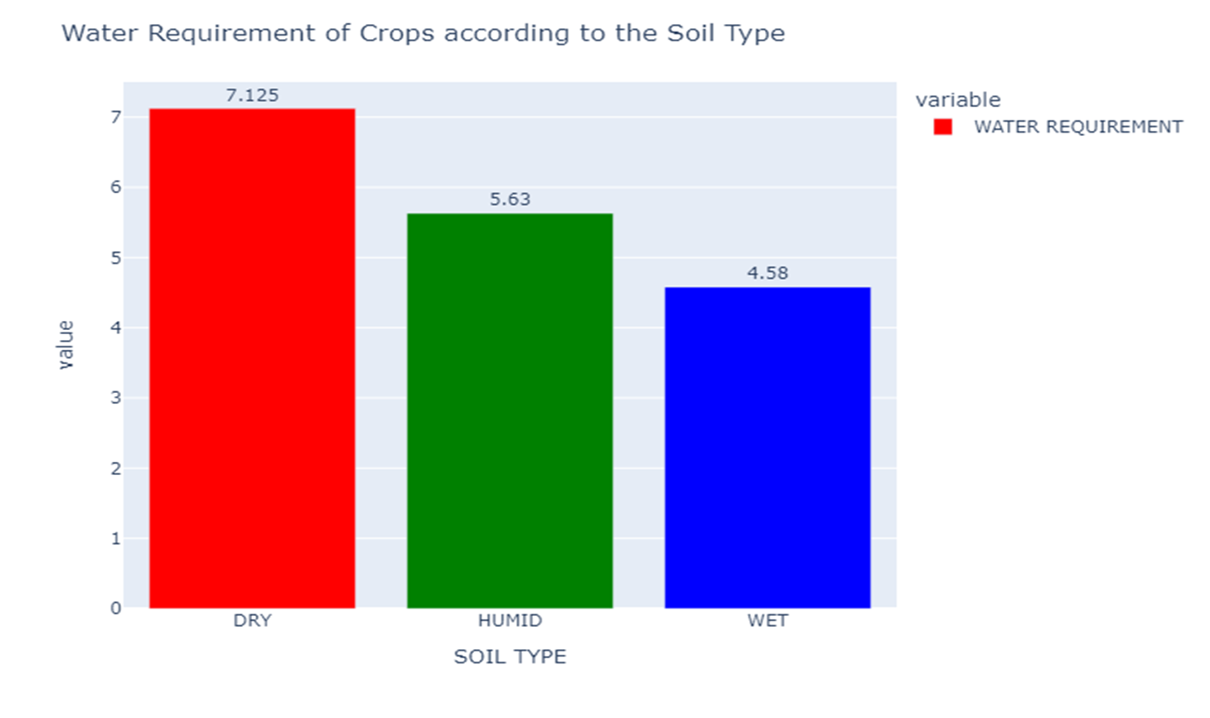
DATA VISUALISATION

Slide 9
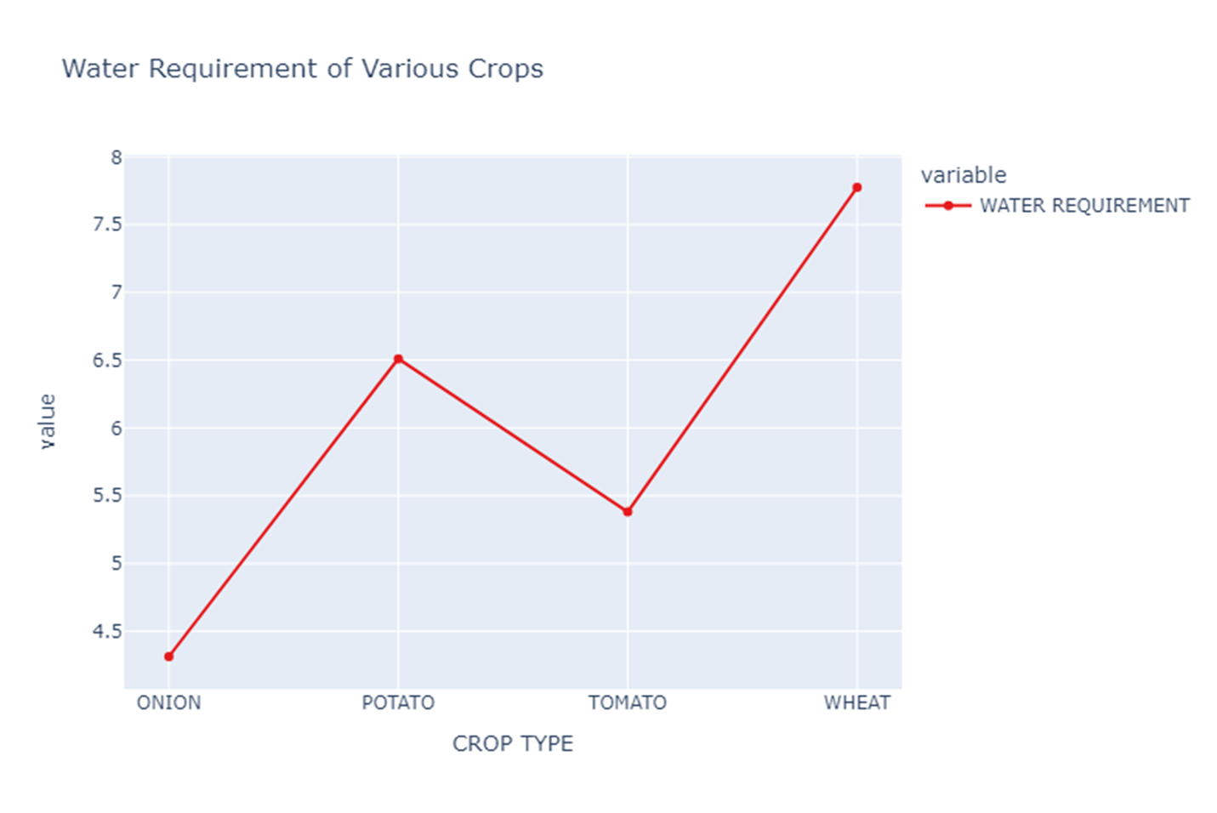
DATA VISUALISATION

Slide 10
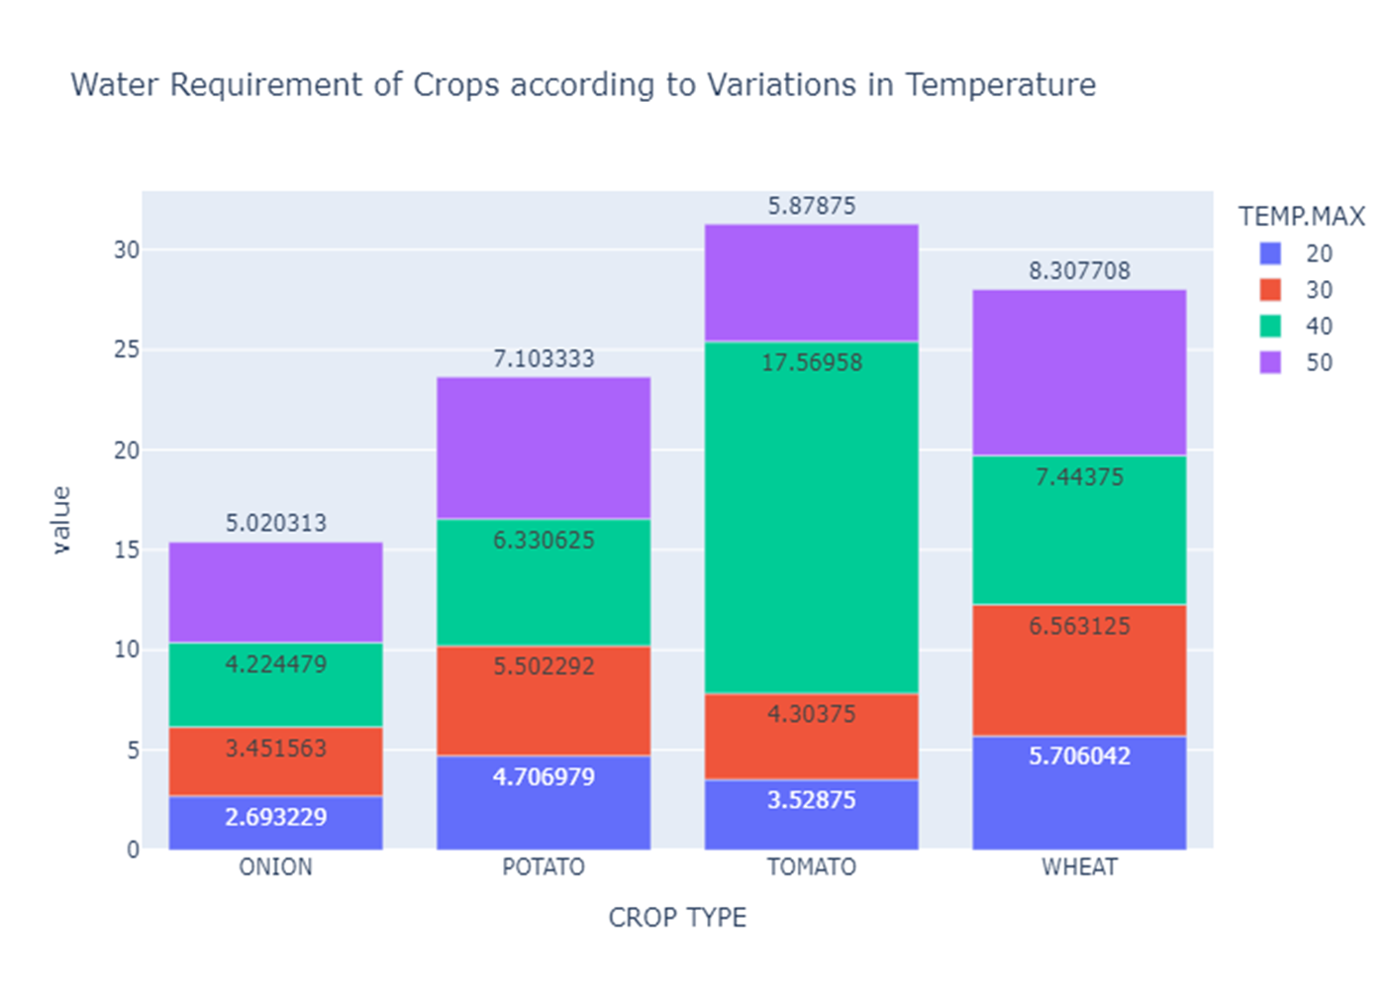
DATA VISUALISATION

Slide 11


Machine Learning Model
Random Forest Algorithm
Training Score | Testing Score
99.6353676570354 | 98.04742744156874

Slide 12
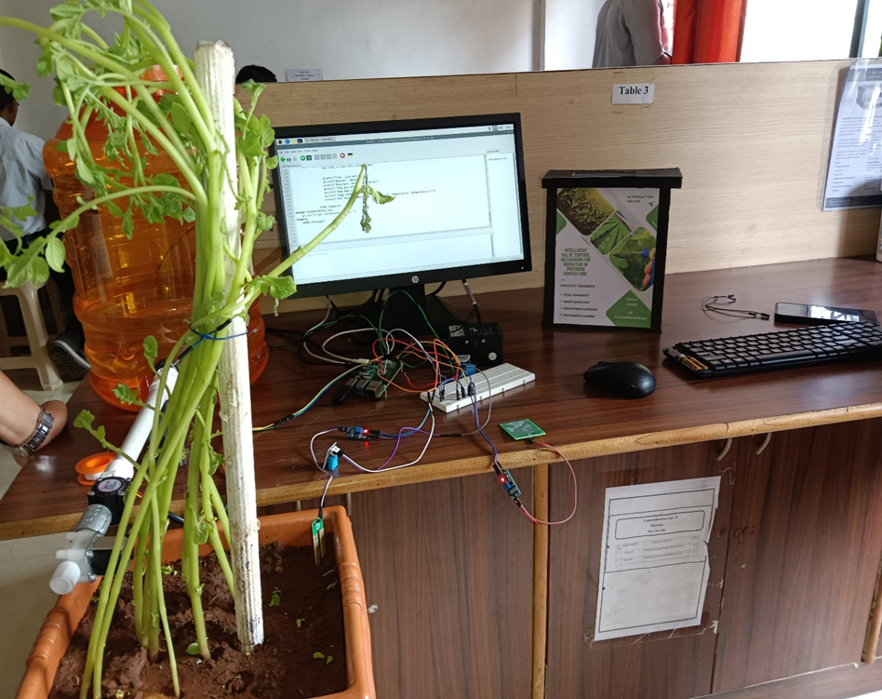
System Implementation

Slide 13
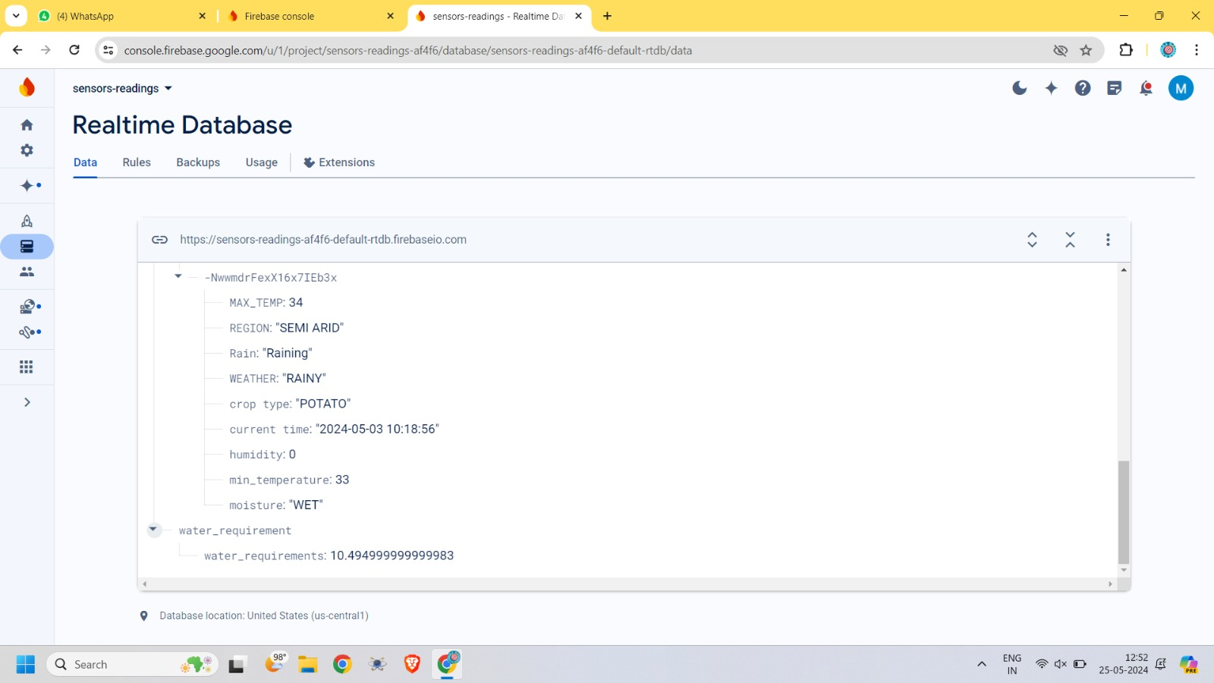
Firebase Data

Slide 14




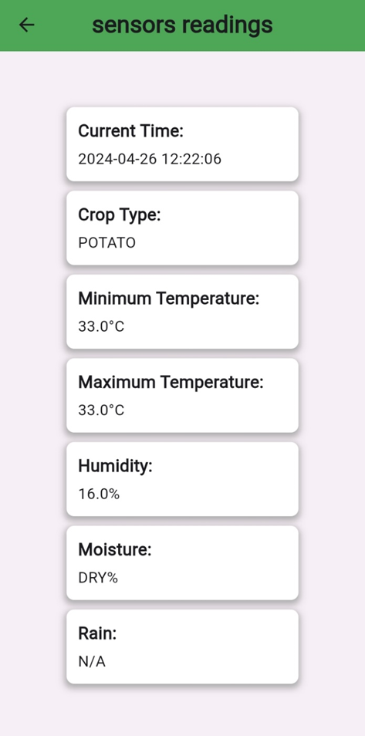
Flutter App

Slide 15
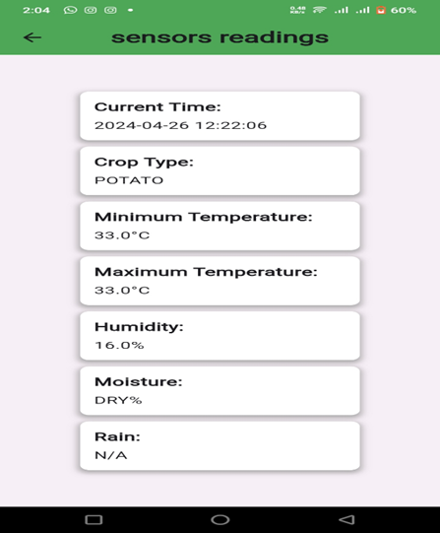
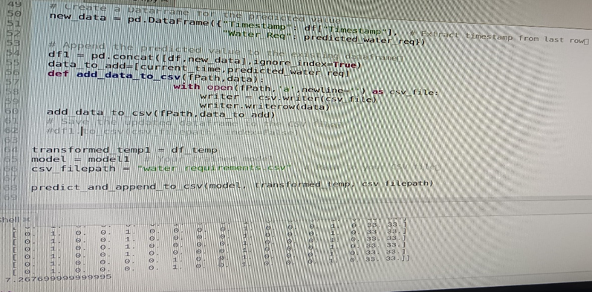
Results
Sensor data acquisition
Water Requirement Prediction

Slide 16
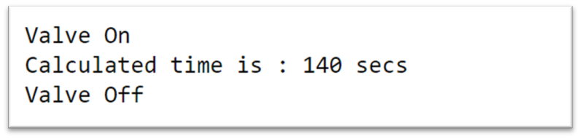
Results
Valve Control

Slide 17
Conclusion
In conclusion, the "Intelligent Valve Control Mechanism for Irrigation in Precision Agriculture" project represents a significant advancement in the field of agriculture through the integration of IoT and machine learning technologies. The project's main objective was to develop a system that could effectively manage irrigation in agricultural fields to maximize crop yield while minimizing water wastage. By combining hardware components such as moisture sensors, humidity sensors, rain sensors, and a flow solenoid valve with a sophisticated machine learning model, the project has successfully achieved its goal.

Slide 18


Our Team
Sejal Hanmante
Rameshwari Kadrame
Mohit Badgujar
Prathamesh Sharma
Guide : Dr. M.P.Hajare

Slide 19

AI IRRIGATION
SQUAD
THANK YOU

